Slide 1
Quality assurance GUIDE

Slide 2
Presentation summary
Automation test using selenium
Manual testing
Azure devops

Slide 3
Automation test using selenium
Selenium test was conducted using test data provided in excel
Image 1: Test Data Excel

Slide 4
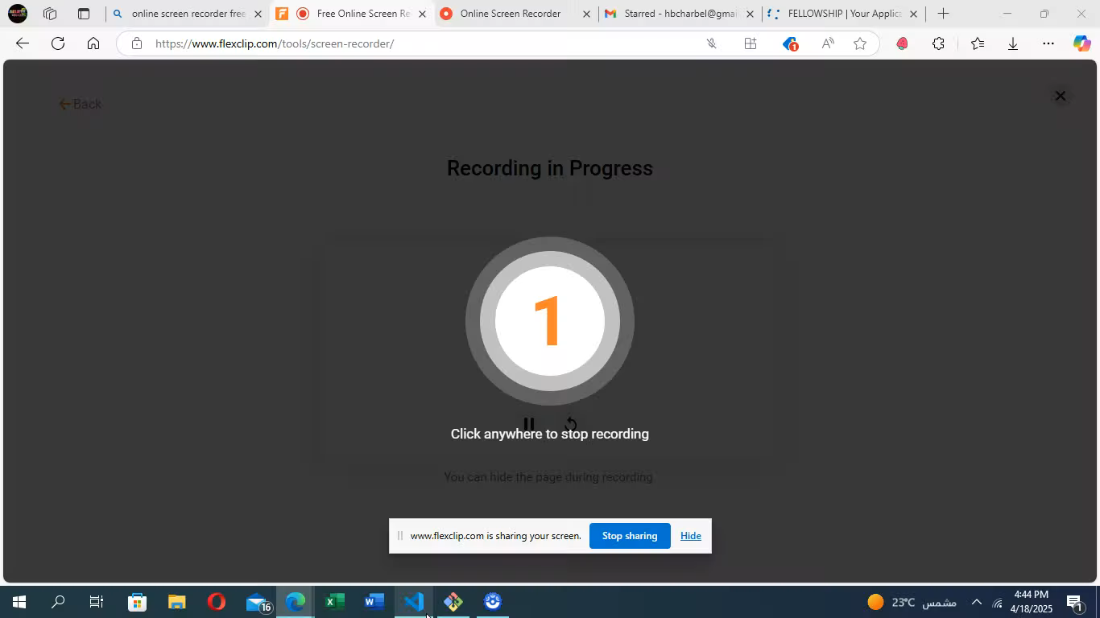
Automation test using selenium
Selenium test was conducted using selenium web driver as shown in video below
Video 1: Adding Education with Selenium WebDriver

Slide 5
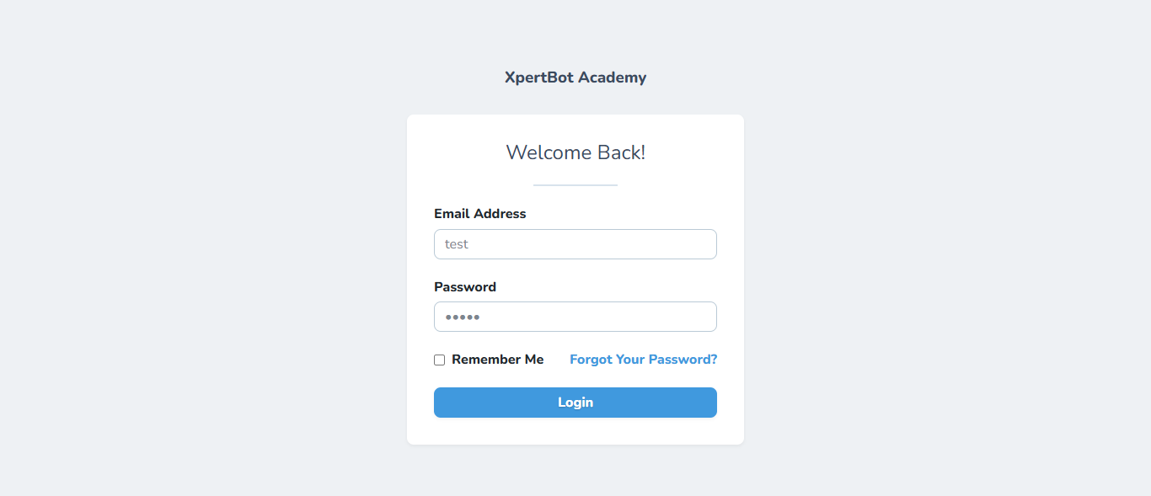
Automation test using selenium
Selenium test failed for invalid email addresses
Image 3: Test Failed for Invalid Email Addresses

Slide 6
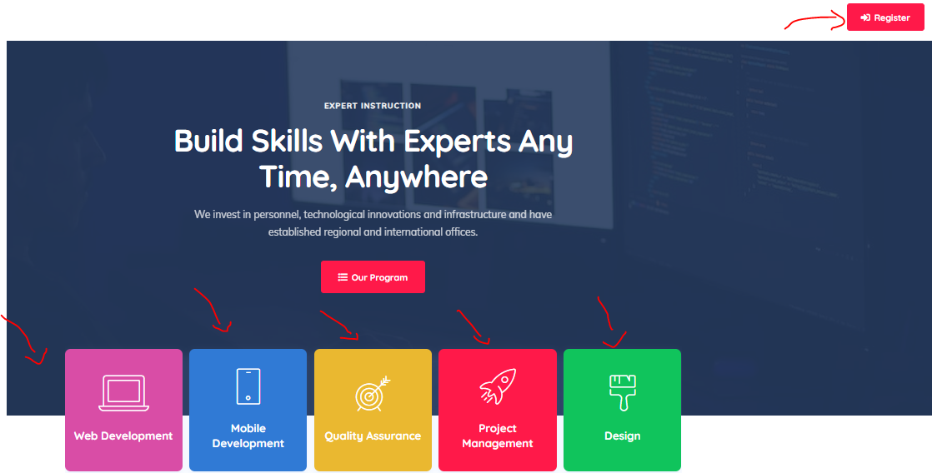

Manual testing
Functional Error when clicking the register icon it refreshes and an error is shown in the console below.
Also when clicking on our program and any of the tracks icons: QA, Web, Mobile .. Nothing happens which is also a functional error
Recording provided through Jam Link : https://jam.dev/c/ae185c41-9f74-4cb9-af24-d47daa9483e8
Image 4: Functional Error – Register Button
Image 5: Error Displayed in the Console

Slide 7
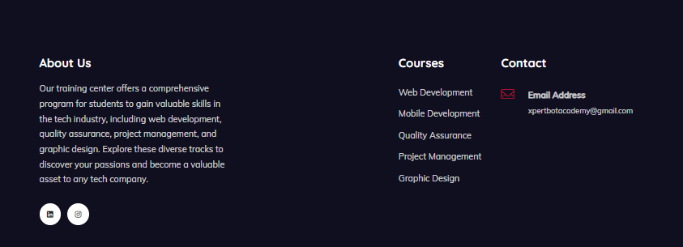
Manual testing
None of the buttons below the courses work
Jam Link: https://jam.dev/c/d5e2a3ea-b1cf-435e-abcb-5cb4183adecc
Image 6: Functional Error - Courses

Slide 8
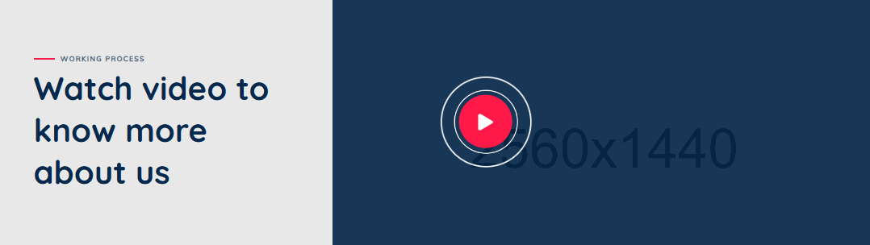
Manual testing
When clicking on the play video, the page refreshes and the video doesn't play.
Jam link: https://jam.dev/c/c340ecb1-c6f1-459f-b1a7-9909e4592d4f
Image 7: Functional Error – Watch video

Slide 9
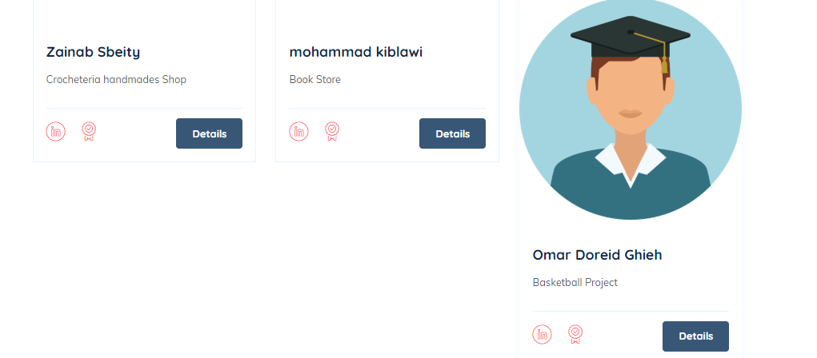
Manual testing
UI/UX Error: Some of the icons in the student’s page are much larger than the others.
This directly appears when clicking on the students link page
Jam Link: https://jam.dev/c/7ef6b1ab-4b04-42e4-bee2-0387e684888f
Image 8: UI/UX Error - Students

Slide 10
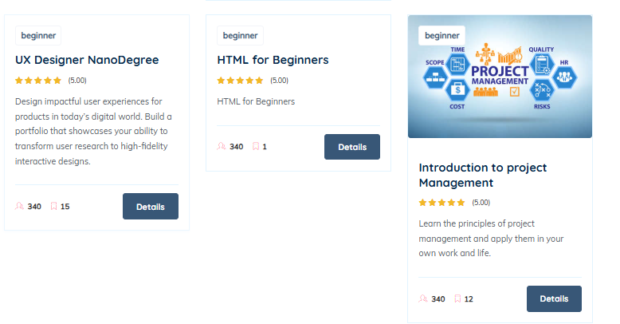
Manual testing
UI/UX Error: Some of the icons in courses are bigger than others.
This directly appears in the in-demand courses offered by professionals.
Jam Link: https://jam.dev/c/f475c181-804e-4a54-9335-91dfe87a3ae9
Image 9: UI/UX Error – Courses Info

Slide 11
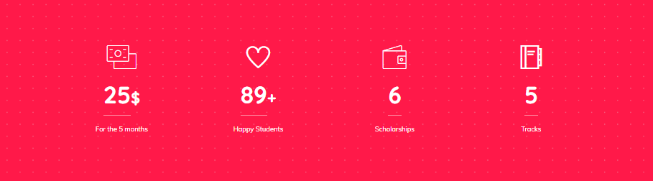
Manual testing
The information provided in the main page is incorrect as the payment & number of tracks is different
Jam link: https://jam.dev/c/e92b89ae-9b6e-4b01-98b9-c26f16bc761f
Image 10: UI/UX Error – Payment & Tracks Info

Slide 12
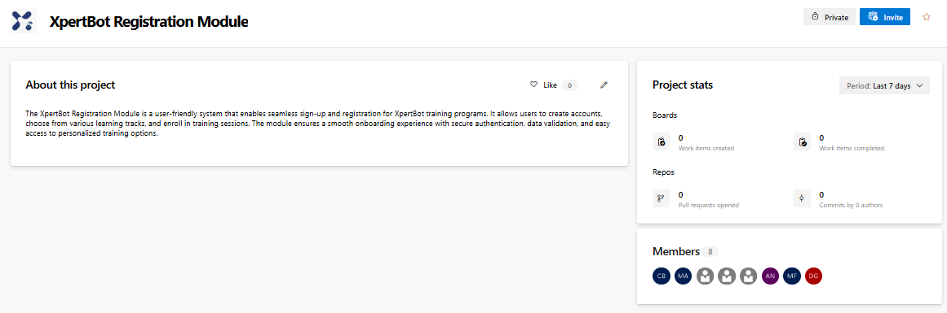
Azure devops
Created a project and invited every member to join
Image 11: Azure Devops Project Creation

